Slide 2
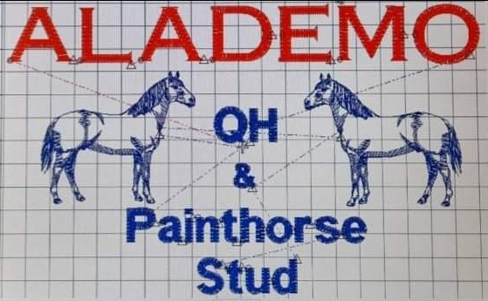

Slide 3
Allison Cousins

Slide 4
Amanda Ilka

Slide 5
Anne Edwards

Slide 11
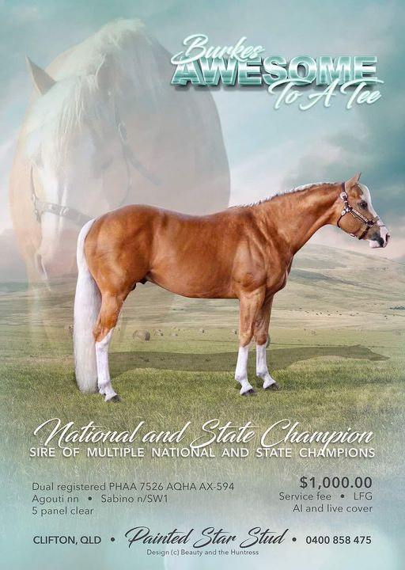

Slide 13
Cath Auld

Slide 17
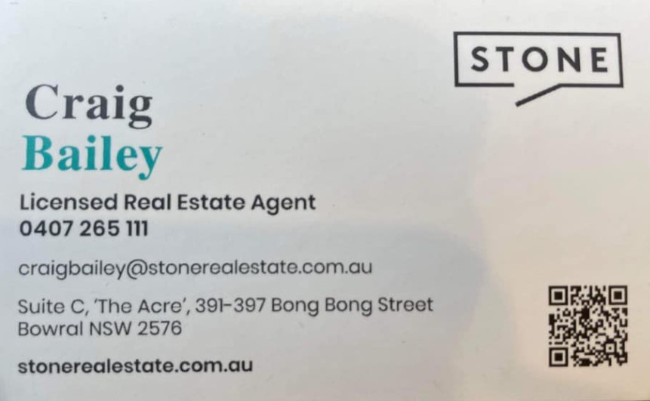

Slide 20
DD Performance Horses

Slide 21
Di & Ron Forester

Slide 22
Dion Assenbruck

Slide 24
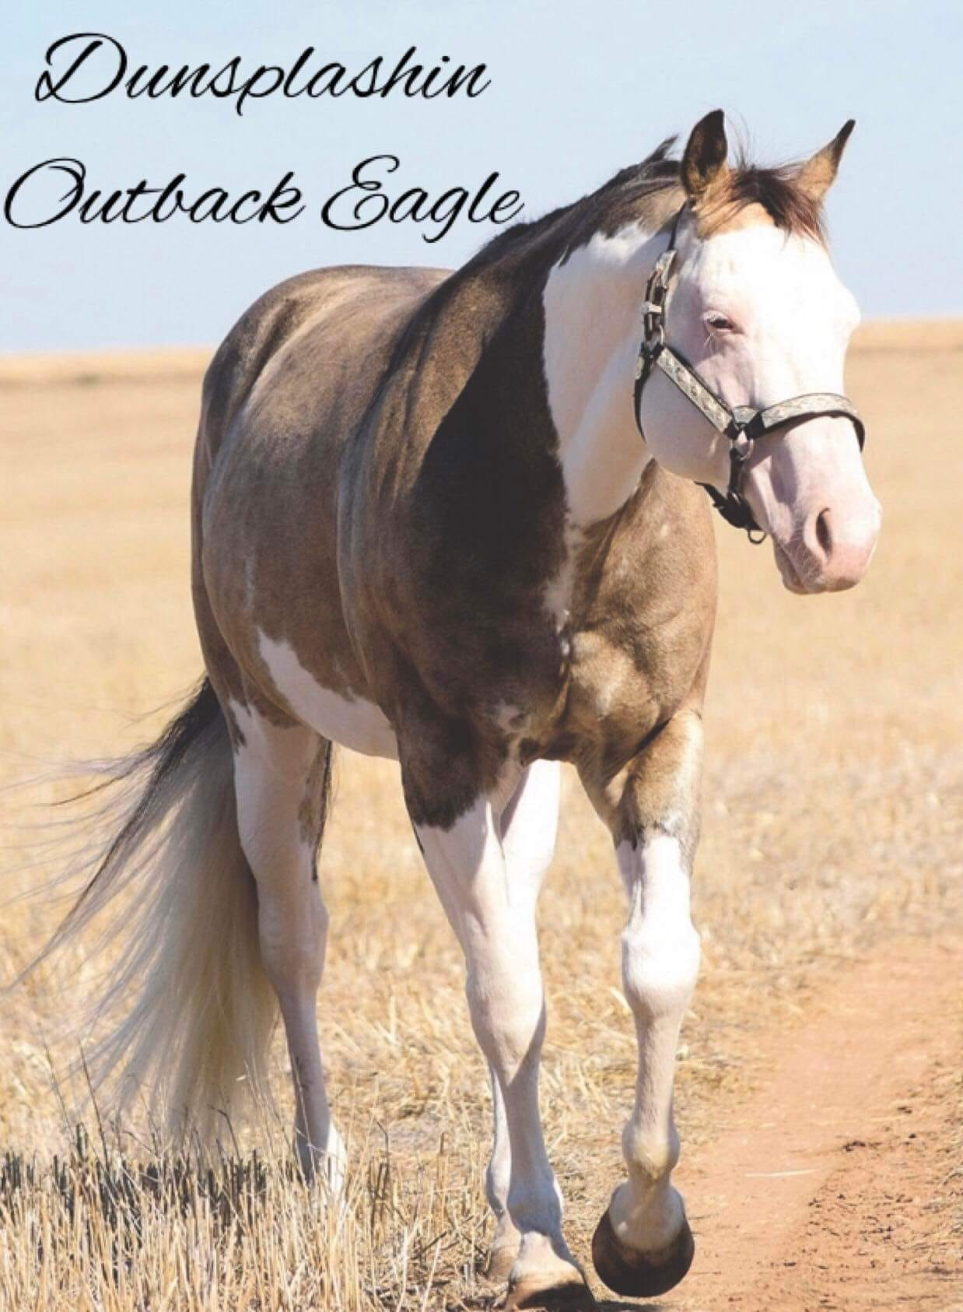

Slide 25
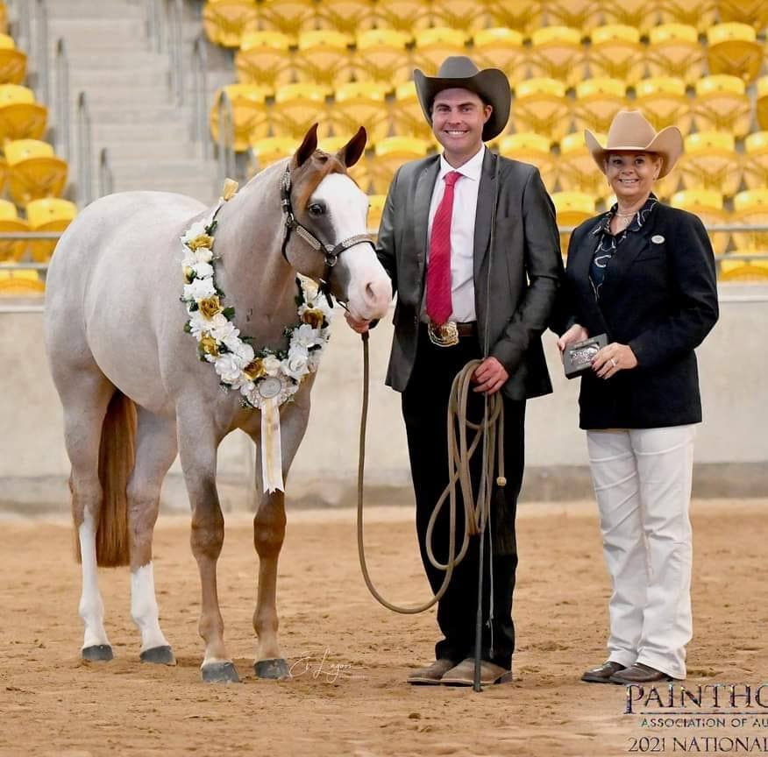
Dylan Hughes Show Horses

Slide 27
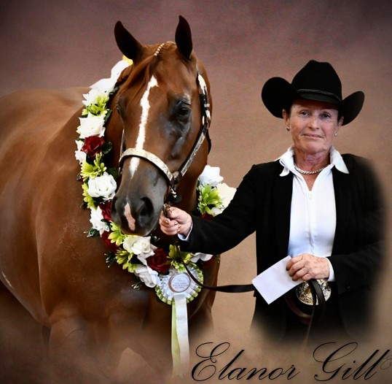

Slide 28
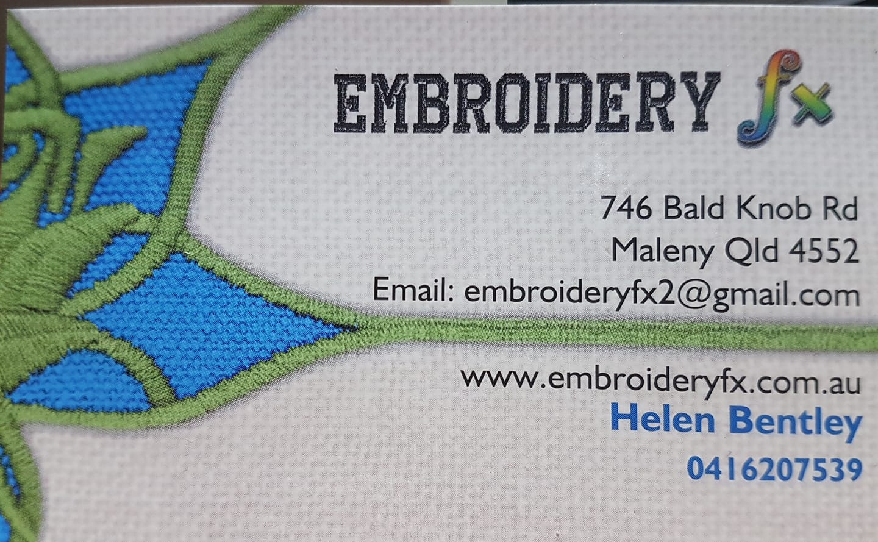

Slide 30
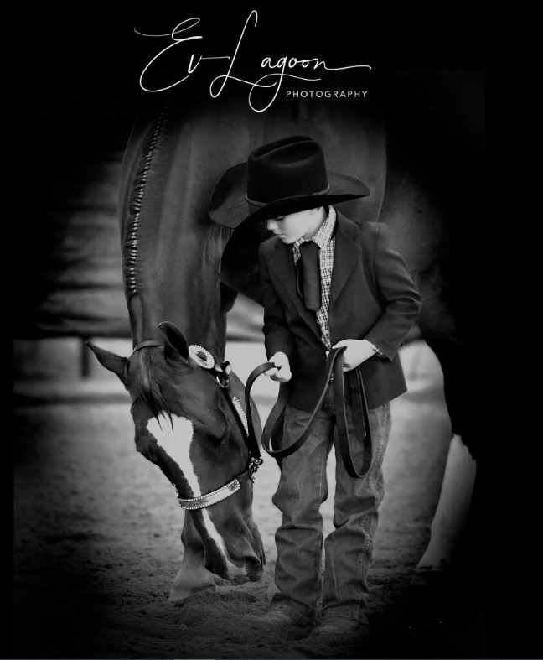

Slide 31
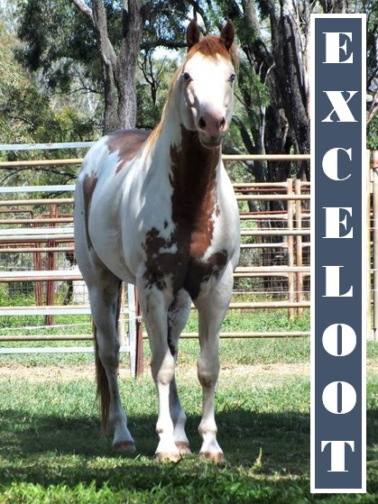

Slide 32
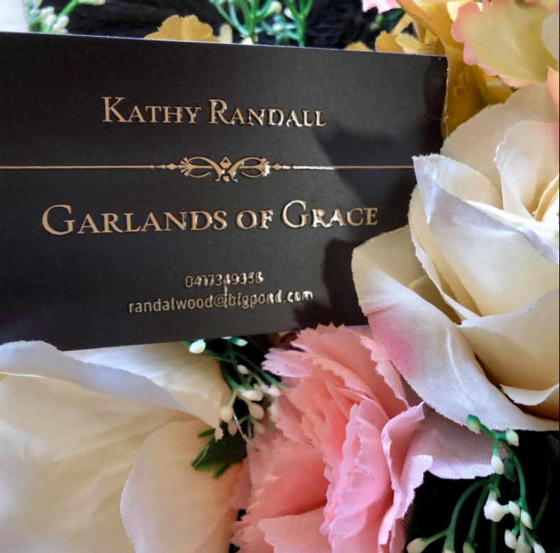

Slide 36
Heather Triffett

Slide 40
Hollie Shields

Slide 41
Irene Norris

Slide 42
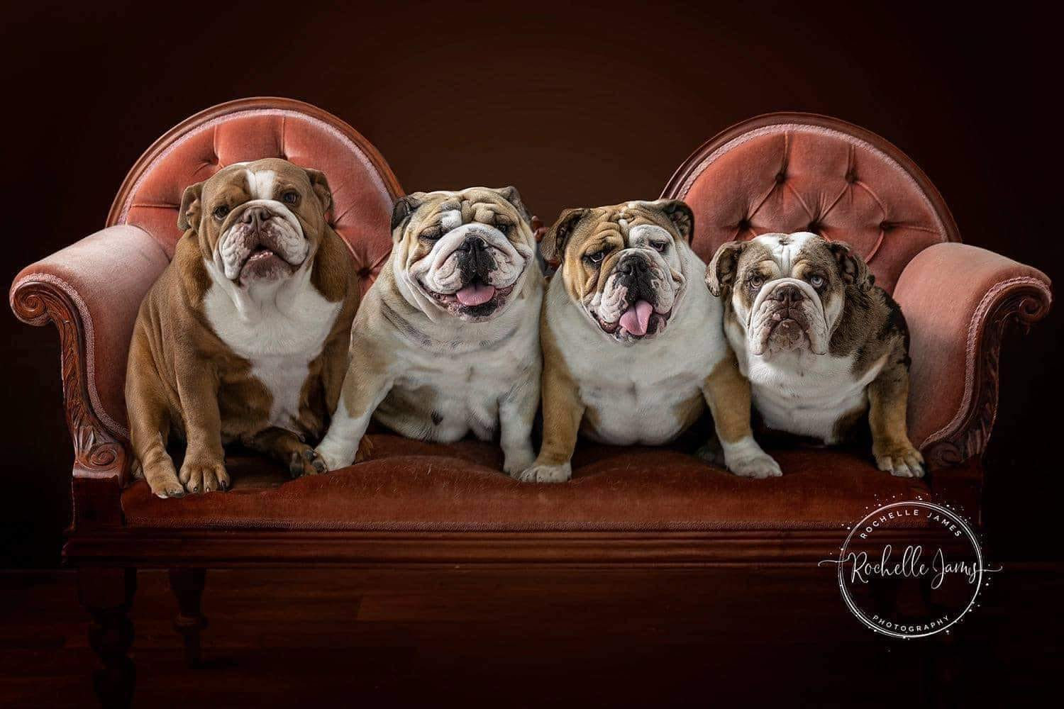

Slide 43
Johnston Family Bookkeeping
Registered BAS Agent & CPA
0438 978 518

Slide 44
Karen Oborn

Slide 45
Karin Brouggy

Slide 47
Kate Seccull

Slide 48
Kathy Bigwood

Slide 53
Leah Helwig

Slide 55
Lee Jennings

Slide 57
Lyn Martin

Slide 58
Lyn White

Slide 60
Michelle Edwards

Slide 62
Munn Family

Slide 64
Narelle Curtis

Slide 65
Natasha Peasley

Slide 66
Neva Craig

Slide 68
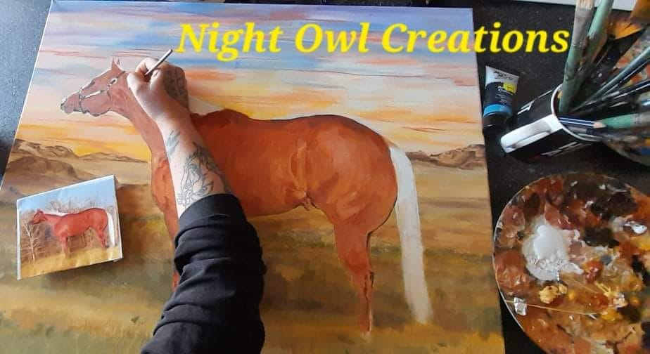

Slide 72
Peter Hall

Slide 73
Peters Family
& Jojubi

Slide 76
Rachel Longworth

Slide 79
Rebecca Stubbs

Slide 81
Robyn Smith

Slide 82
Robyn White

Slide 84
Sarah Saxer

Slide 89
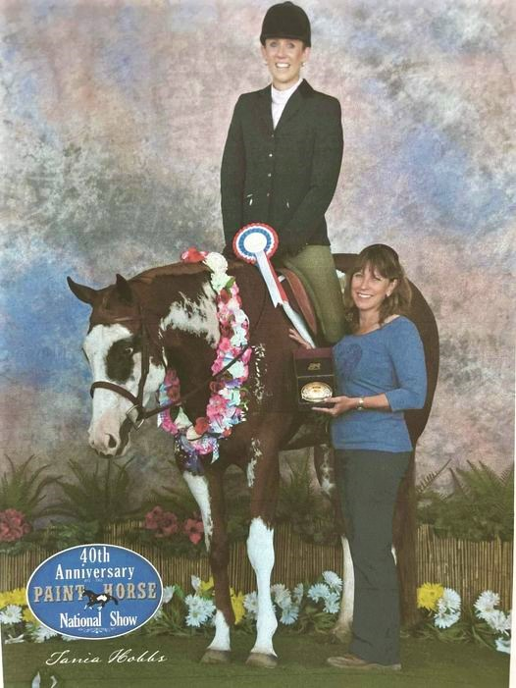
SO
HOT ‘N’
CHARMING

Slide 91
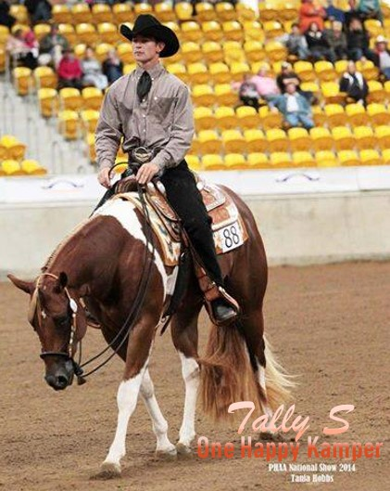

Slide 92
Tanya Pressler-Quinn

Slide 93
Tanya Thomas

Slide 94
Temika Carson

Slide 96
Trevor & Anne Phillips

Slide 99
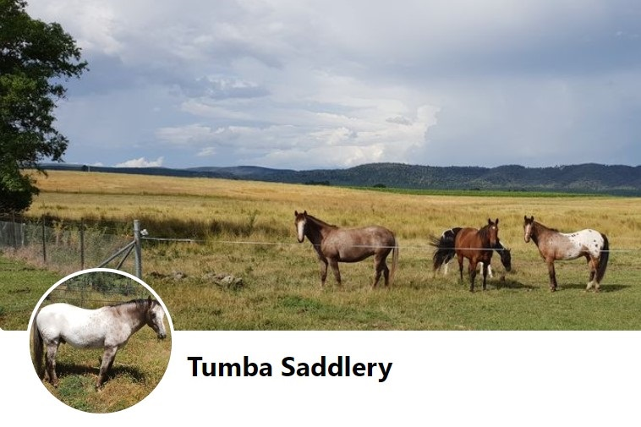

Slide 102
Zan & Tiarna Russ

